Slide 1

RNS INSTITUTE OF TECHNOLOGY
BENGALURU - 98
DEPARTMENT OF INFORMATION SCIENCE & ENGINEERING
Presentation on Internship
Quiz Application
Amritha Kandiyil
USN: 1RN18IS015
ENMAZ Engineering Services Pvt. Ltd.
Internal Guide
Mrs. Vinutha G K
Asst. Prof, Dept of ISE, RNSIT
External Guide
Mr. Akshay D R
Co-Founder & CEO, Enmaz Engineering Services
Pvt.Ltd, Bengaluru
Notes:
‹#›

Slide 2
Agenda
Abstract
About the Company
Introduction
Requirements
System Design
Implementation
Results
Conclusion and Future Enhancements
References
Q & A
VIII Semester, Department of ISE, RNSIT
2021 - 2022
‹#›

Slide 3
Abstract
Manually conducting exams/tests and checking students’ scores is one of the key areas where a lot of time is wasted. This time could have otherwise been used effectively for a productive study time.
Replacing these manual tasks of conducting exams, correcting the answer scripts and giving scores, with some comprehensive apps can save a lot of precious teaching time.
Also, since all these tasks are being performed by humans, the chances of errors occurring are more.
Quiz application is developed so that students can prepare for an examination or can have a quick revision of whatever they have learnt.
As soon as an answer is selected, the computer displays if it is true or false and scores will be counted automatically. An option will be given to reset the test if required.
VIII Semester, Department of ISE, RNSIT
2021 - 2022
‹#›

Slide 4
About the Company
Enmaz is the IT services company registered under Govt. of India, Ministry of Micro, Small & Medium Enterprises.
Their mission is to empower their customers with necessary knowledge, skills and resources for them to succeed in their endeavors.
Enmaz has a simple yet robust solution that helps any Industry/Factory digitise their work floor in no time.
The products offered will help in remote monitoring ,controlling and also analysing and machine parameter or process.
VIII Semester, Department of ISE, RNSIT
2021 - 2022
‹#›

Slide 5
Introduction
Quiz application is an application developed for learning and improving knowledge in the educational area. This application can be used in schools, colleges and also by students themselves before a test or examination to evaluate themselves or even for a quick revision.
In the existing system, the students have to manually contact the teacher to conduct examinations and also, a single examination for a single student cannot be done. It will be tedious for the teacher to when a large number of students want to check their scores. The human effort is more here.
To overcome the drawbacks mentioned above, the proposed system has been developed. This project has been developed so that a student can easily test themselves and have a quick revision. The interface is easy to understand and is extremely user friendly.
VIII Semester, Department of ISE, RNSIT
2021 - 2022
‹#›

Slide 6
Requirements
Hardware Requirements
• CPU: Pentium processor and above
• RAM: 4 GB
• HDD: 40 GB
Software Requirements
• Operating System: Windows 8 and above
• Front-end Design: Visual Studio Code
• Front-end Language: Dart
VIII Semester, Department of ISE, RNSIT
2021 - 2022
‹#›

Slide 7
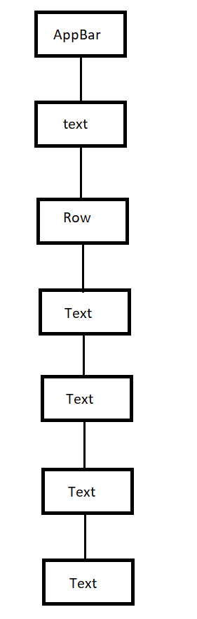
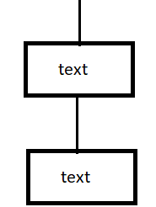
System Design
Widget tree :
VIII Semester, Department of ISE, RNSIT
2021 - 2022
‹#›
Notes:
‹#›

Slide 8
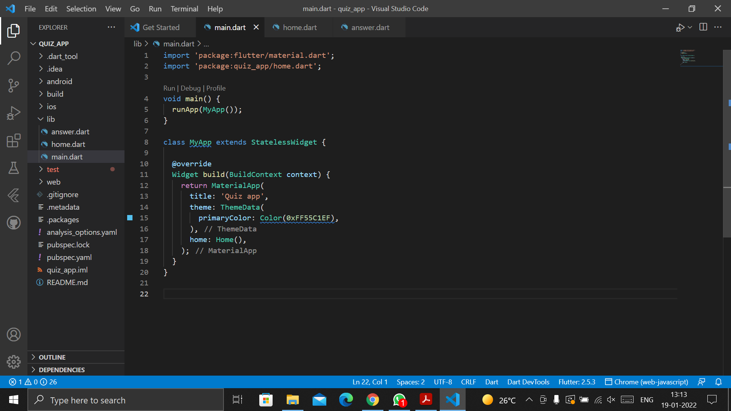
Implementation / Coding
main.dart
VIII Semester, Department of ISE, RNSIT
2021 - 2022
‹#›
Notes:
‹#›

Slide 9
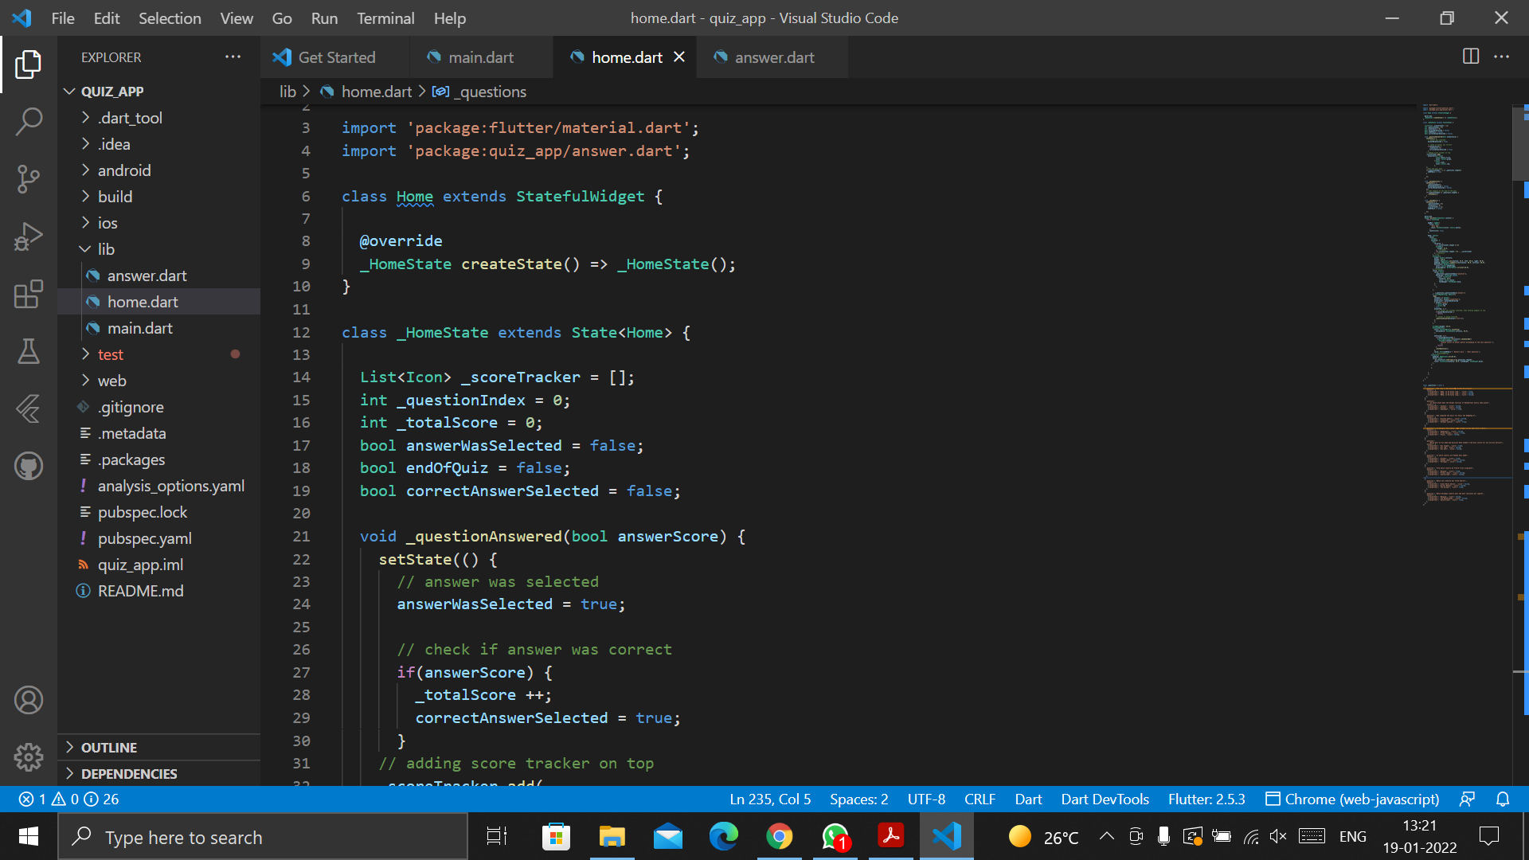
Implementation / Coding
home.dart
VIII Semester, Department of ISE, RNSIT
2021 - 2022
‹#›
Notes:
‹#›

Slide 10
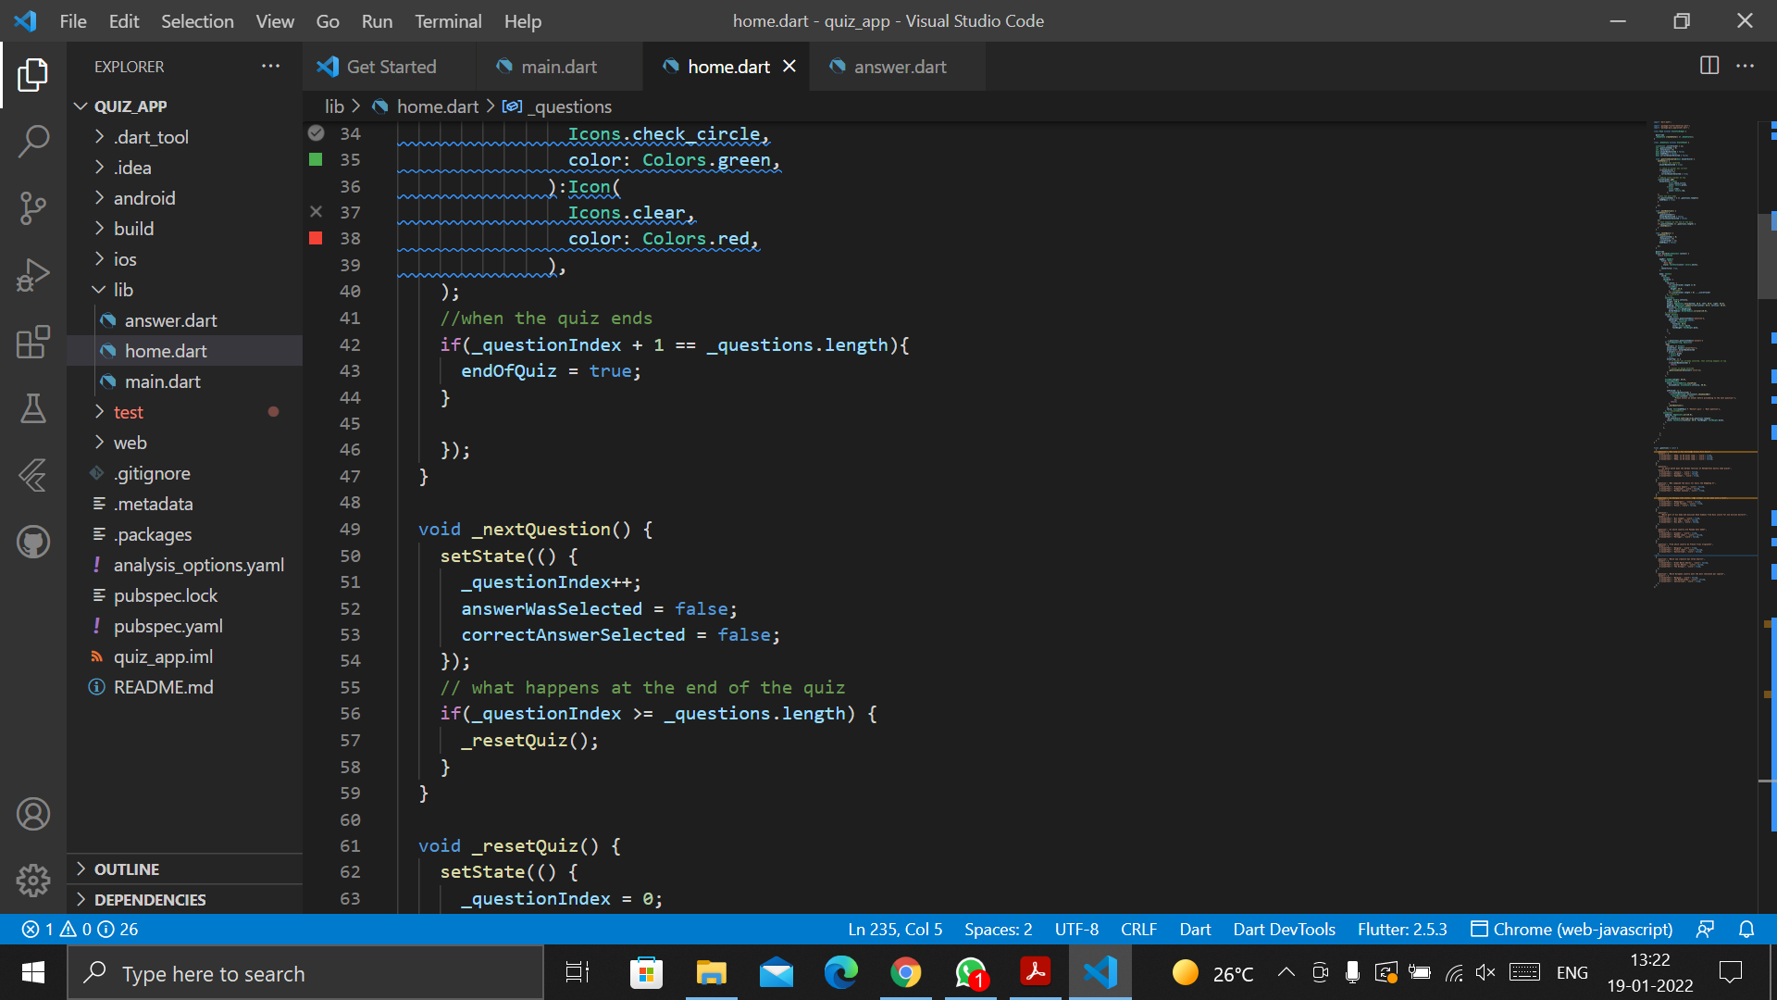
Implementation / Coding
VIII Semester, Department of ISE, RNSIT
2021 - 2022
‹#›
Notes:
‹#›

Slide 11
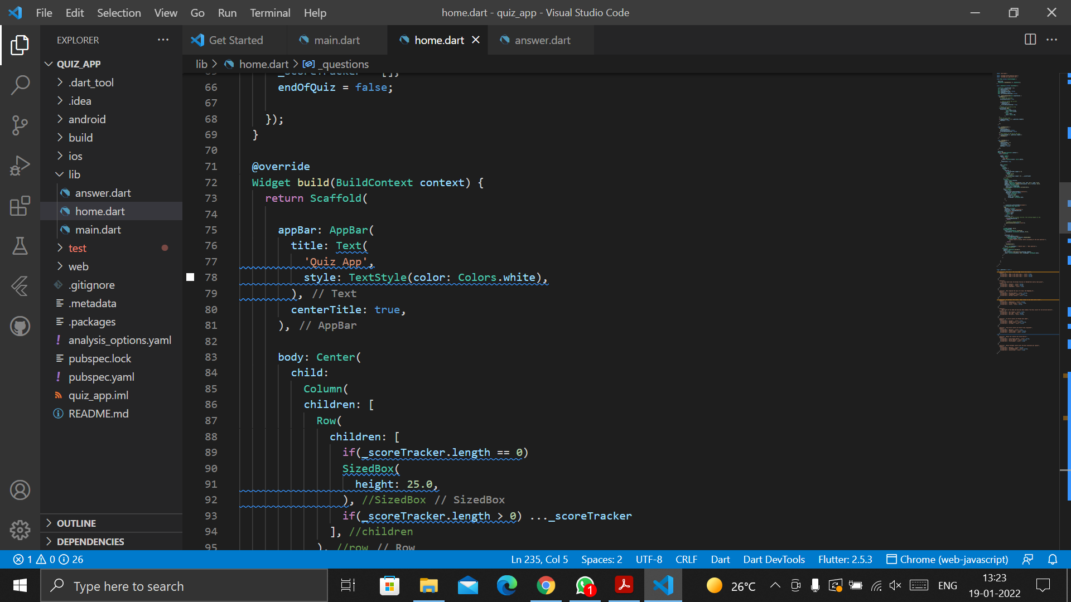
Implementation / Coding
VIII Semester, Department of ISE, RNSIT
2021 - 2022
‹#›
Notes:
‹#›

Slide 12
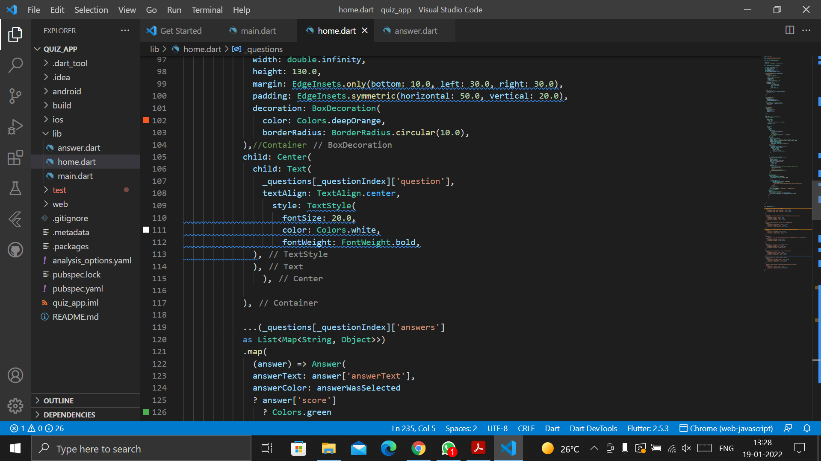
Implementation / Coding
VIII Semester, Department of ISE, RNSIT
2021 - 2022
‹#›
Notes:
‹#›

Slide 13
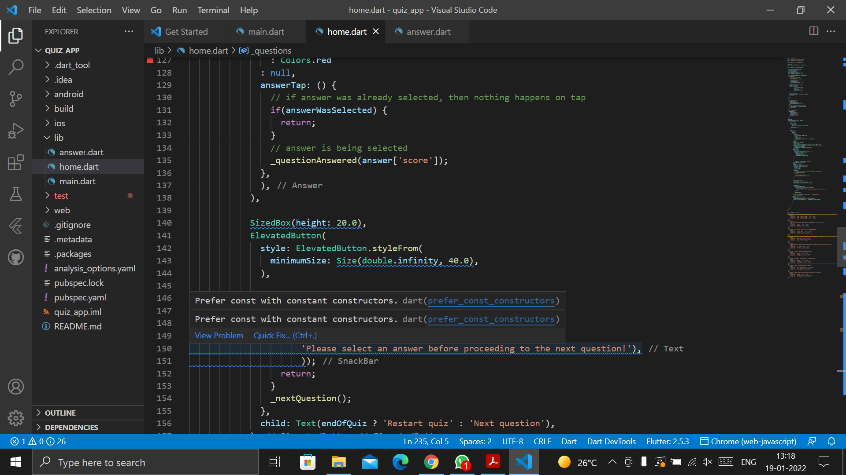
Implementation / Coding
VIII Semester, Department of ISE, RNSIT
2021 - 2022
‹#›
Notes:
‹#›

Slide 14
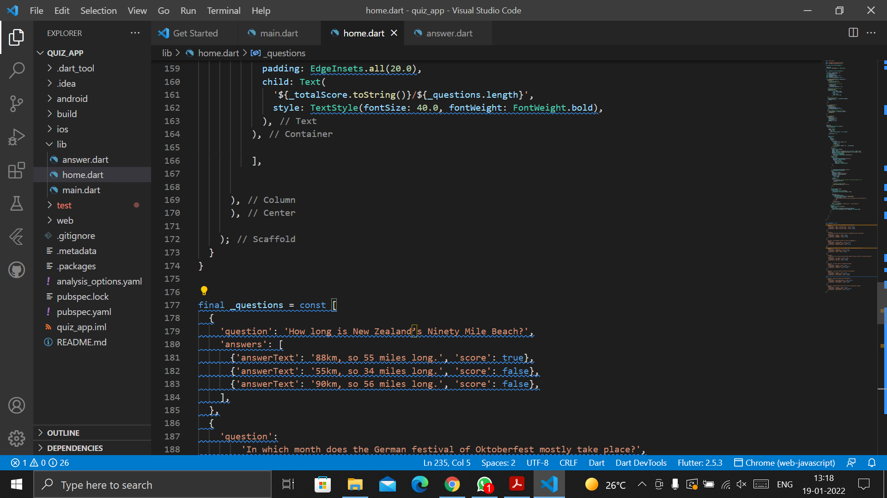
Implementation / Coding
VIII Semester, Department of ISE, RNSIT
2021 - 2022
‹#›
Notes:
‹#›

Slide 15
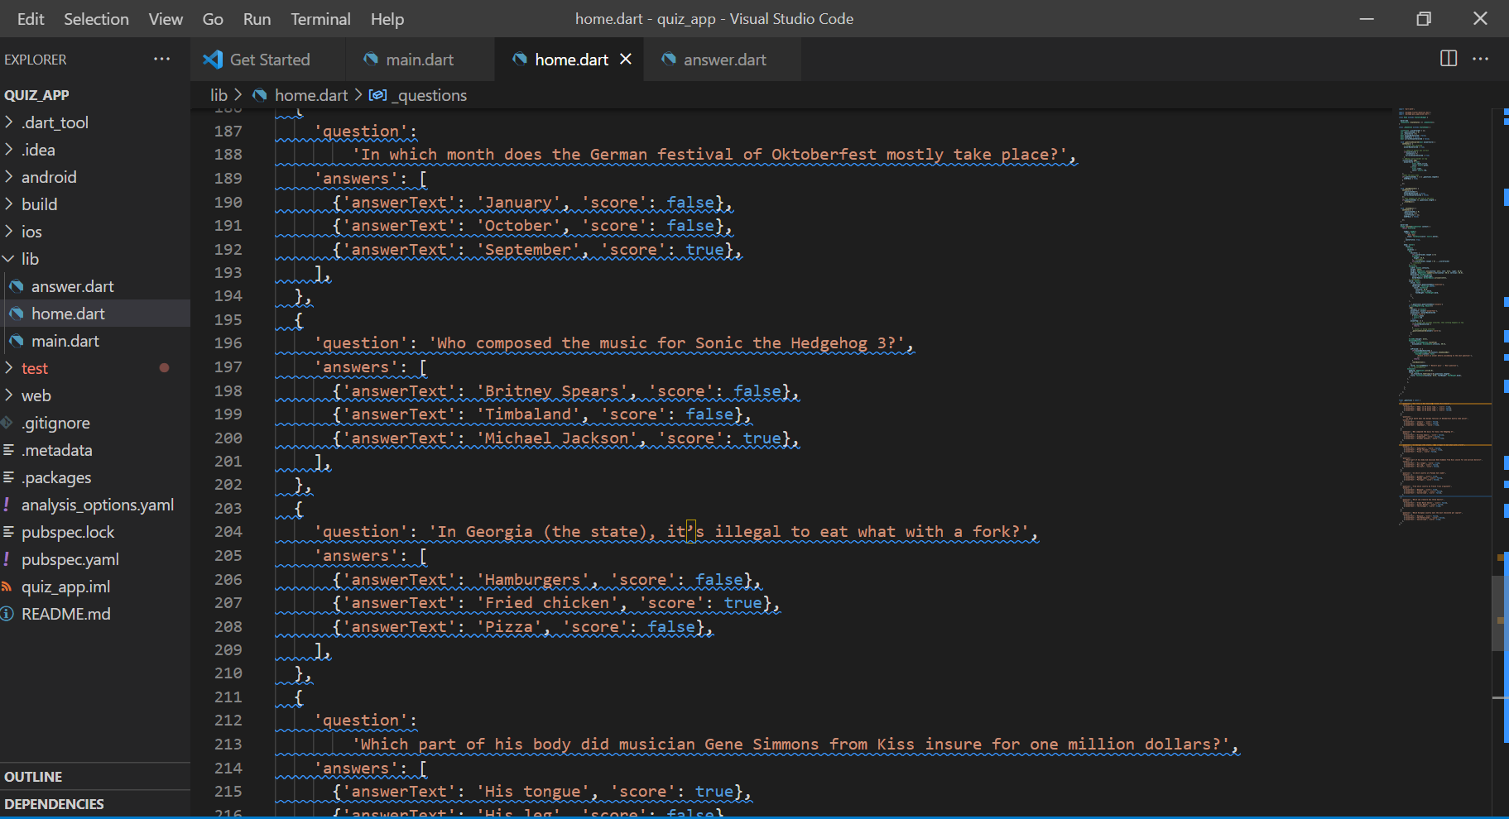
Implementation / Coding
VIII Semester, Department of ISE, RNSIT
2021 - 2022
‹#›
Notes:
‹#›

Slide 16
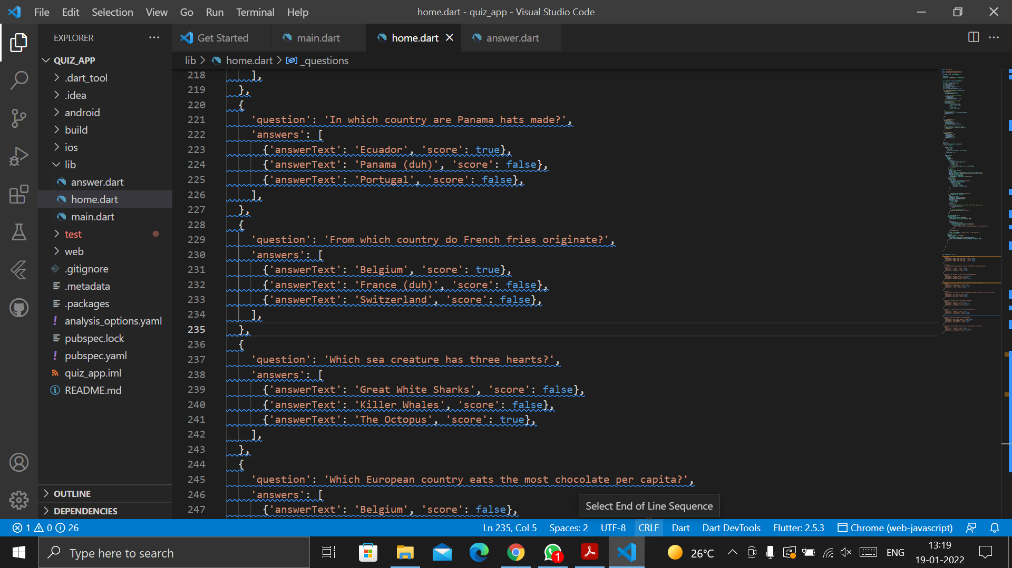
Implementation / Coding
VIII Semester, Department of ISE, RNSIT
2021 - 2022
‹#›
Notes:
‹#›

Slide 17
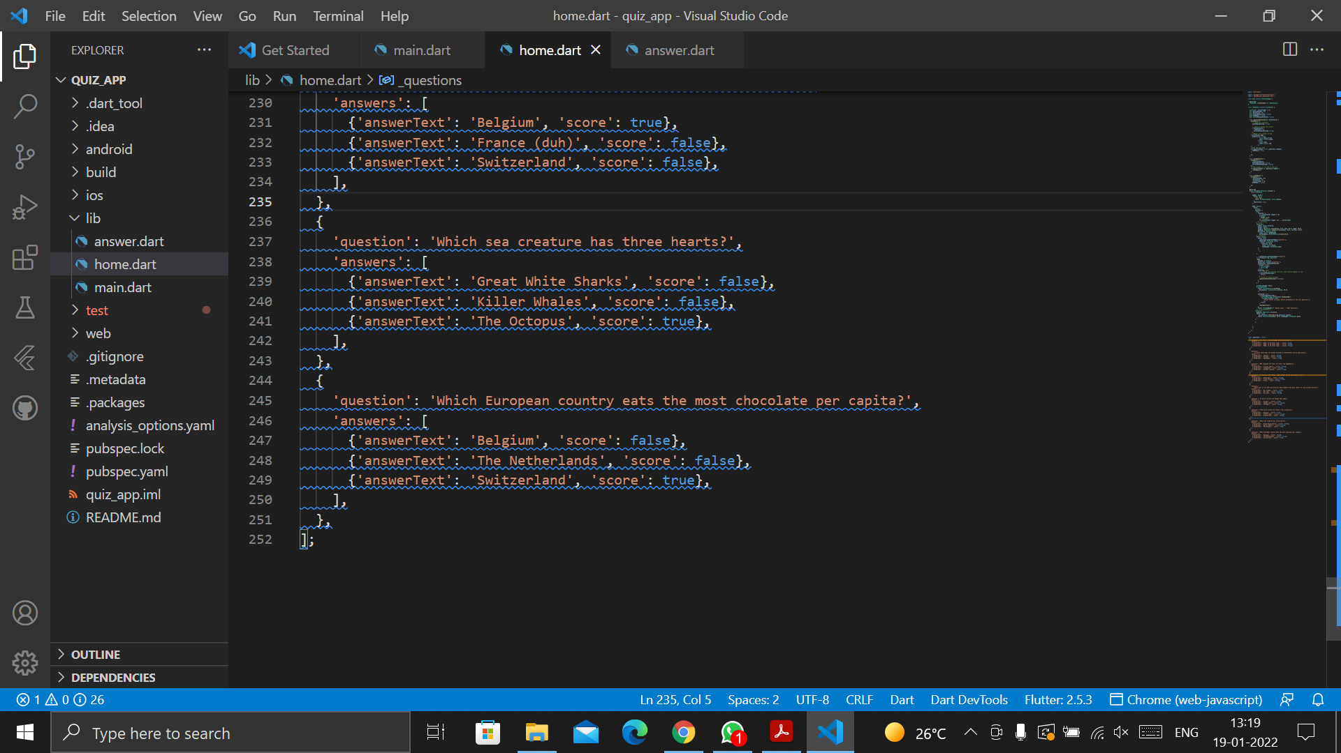
Implementation / Coding
VIII Semester, Department of ISE, RNSIT
2021 - 2022
‹#›
Notes:
‹#›

Slide 18
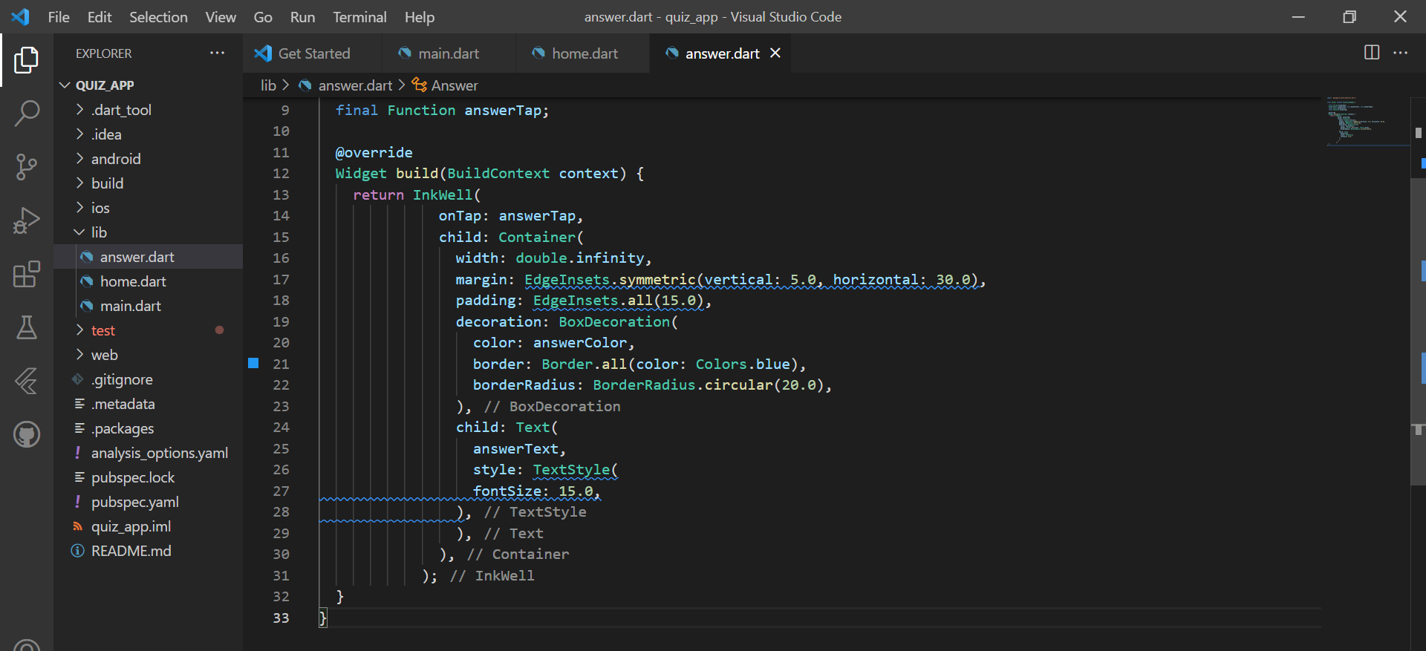
Implementation / Coding
answer.dart
VIII Semester, Department of ISE, RNSIT
2021 - 2022
‹#›
Notes:
‹#›

Slide 19
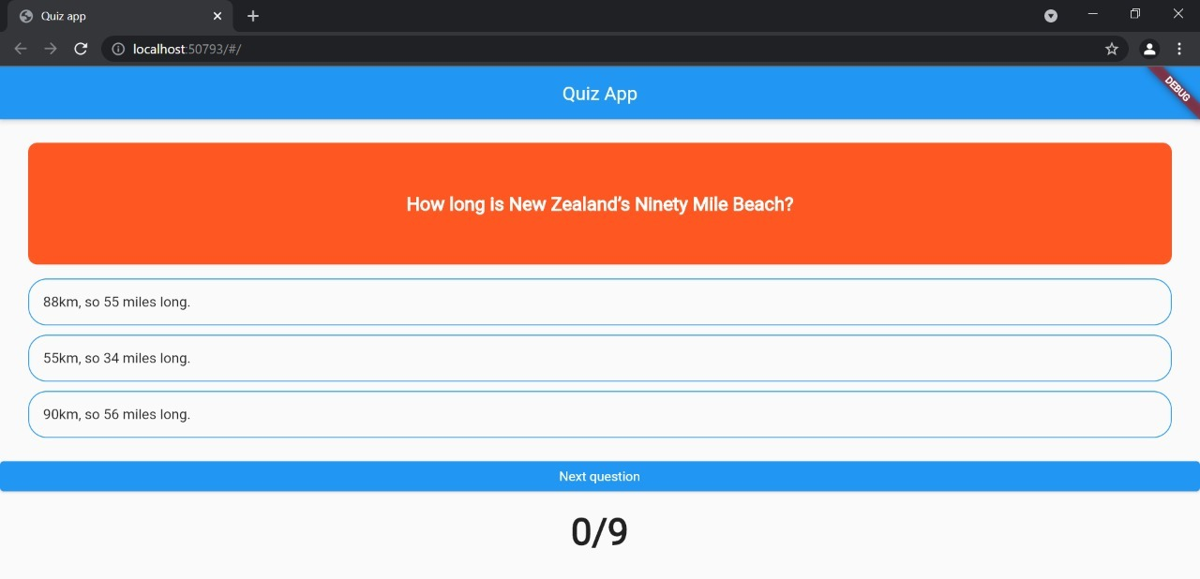
Results
Questions screen
VIII Semester, Department of ISE, RNSIT
2021 - 2022
‹#›
Notes:
‹#›

Slide 20
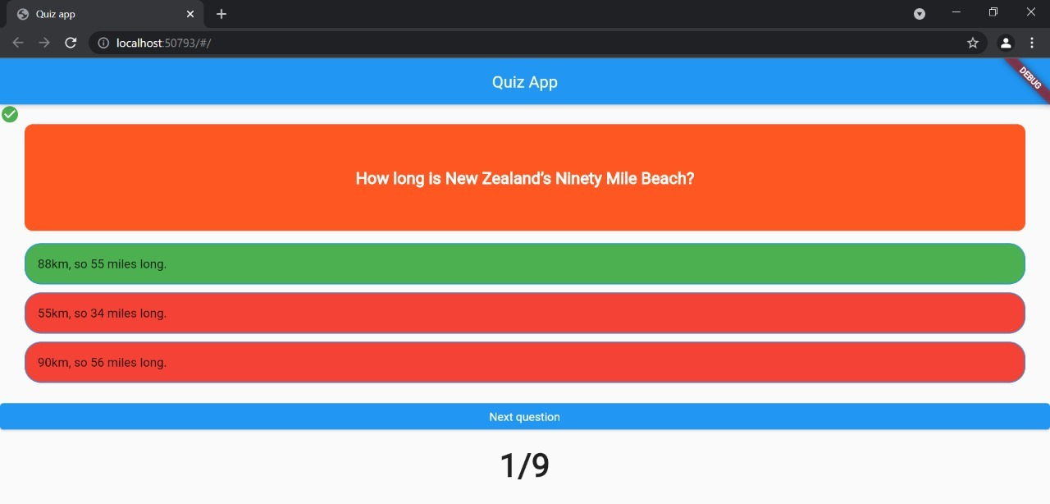
Results
Evaluation of answers - true
VIII Semester, Department of ISE, RNSIT
2021 - 2022
‹#›
Notes:
‹#›

Slide 21
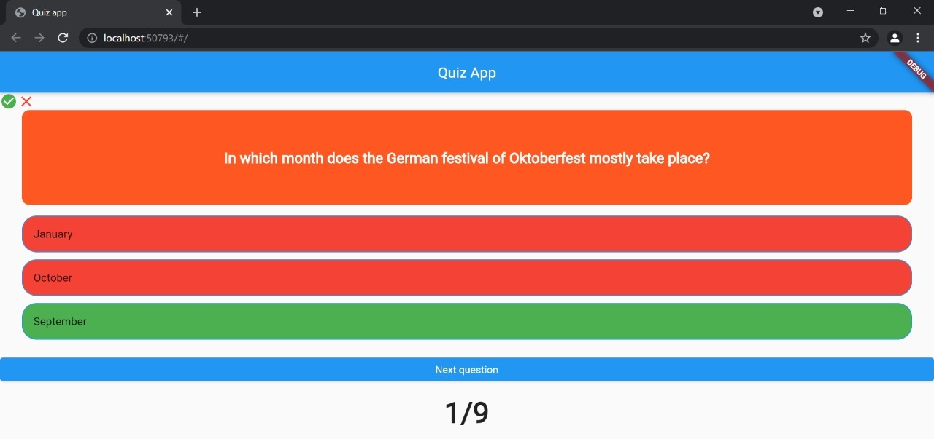
Results
Evaluation of answers - false
VIII Semester, Department of ISE, RNSIT
2021 - 2022
‹#›
Notes:
‹#›

Slide 22
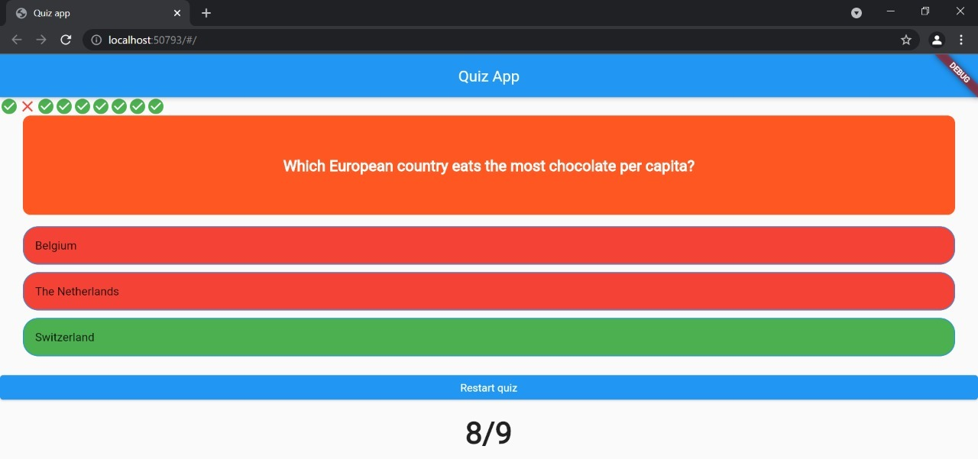
Results
Score is displayed
VIII Semester, Department of ISE, RNSIT
2021 - 2022
‹#›
Notes:
‹#›

Slide 23

Results
Restart quiz
VIII Semester, Department of ISE, RNSIT
2021 - 2022
‹#›
Notes:
‹#›

Slide 24
Conclusion
The main purpose of our project is to develop an application that offers new aspects of learning and improving knowledge in the educational area.
Nowadays, most of the students have smart phones and tablets, which can support applications (apps) for mobile devices. Therefore, to make a profitable use of them in order to review the concepts covered in class we have implemented this application.
The main objective of this research is to study the use of mobile apps as supporting tools in the education context.
We have learned a lot about Android based applications and also about user’s behaviour. We have found that the development process is hard and time-consuming, but it can be managed by a team work. We hope that other developers will take advantage from our experience/from our development.
VIII Semester, Department of ISE, RNSIT
2021 - 2022
‹#›
Notes:
‹#›

Slide 25
Future Enhancements
Future enhancements include:
• HINT button: - by proving some additional information regarding the topic which will help the user to answer the question correctly.
• ELIMINATE: - It will help the user to answer question whenever he/she have a confusion on either of the two options. It helps by disabling two extra options from four options, then user can easily select an option from the two.
• SKIP button: - Skip options can be used as per user’s choice. This function will simply skip the current question and proceed to the next one.
• TIMER: - The timer can be added so that user can practice to answer a particular question within the set time for each and every question. When the user wants some time to answer a question, then he/she will use this function to pause the quiz. As a result, the clock will be stopped for 30 sec and this time is not be added in the total time.
VIII Semester, Department of ISE, RNSIT
2021 - 2022
‹#›
Notes:
‹#›

Slide 26
References
[1] https://flutter.dev/
[2] https://developers.google.com/learn/pathways/intro-to-flutter
[3] https://www.youtube.com/
[4] Beginning Flutter: A Hands On Guide to App Development by Marco L Napoli
VIII Semester, Department of ISE, RNSIT
2021 - 2022
‹#›

Slide 27
Question and Answer
VIII Semester, Department of ISE, RNSIT
2021 - 2022
‹#›

Slide 28
THANK YOU
VIII Semester, Department of ISE, RNSIT
2021 - 2022
‹#›

